Slide 1
M07 - Test Plan Presentation
Team FEED DEAD BEEF

Slide 2
Overview
To design a program that simulates both cache memory and scratchpad memory within the same application
To give the user statistics about cache and scratchpad simulation,
To have a multi core design

Slide 3
What will be tested
User inputted simulation selection
Verification of user input
Multi-core simulation
Return of simulation results

Slide 4
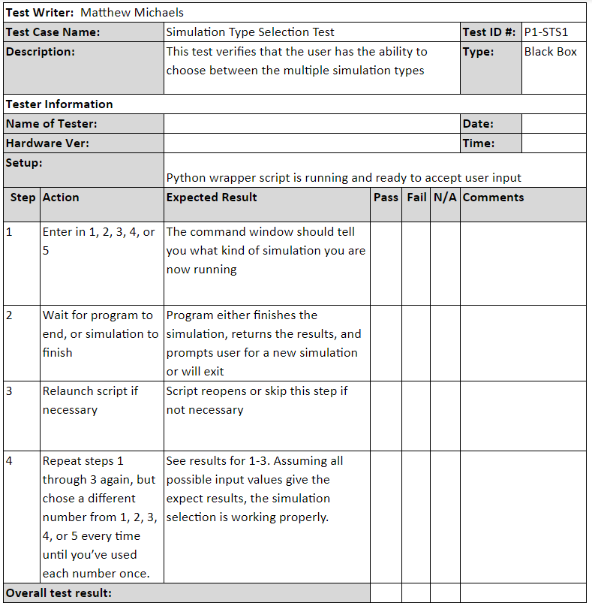
Test #1

Slide 5
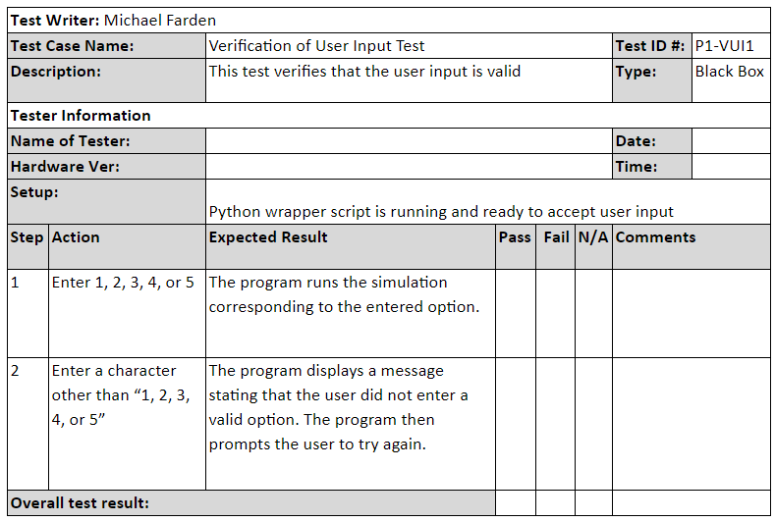
Test #2

Slide 6
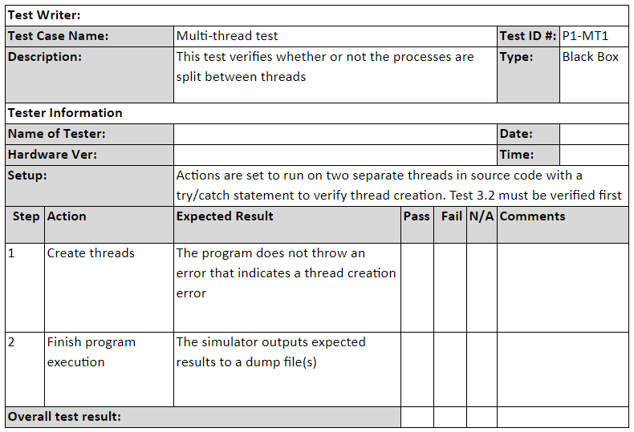
Test #3

Slide 7
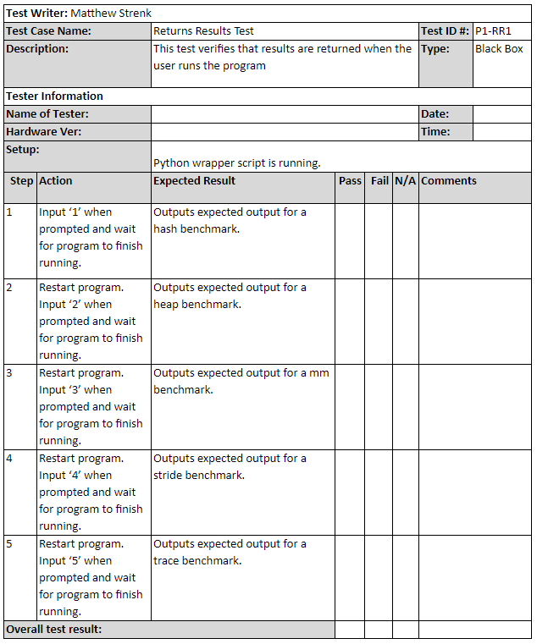
Test #4

